Slide 1
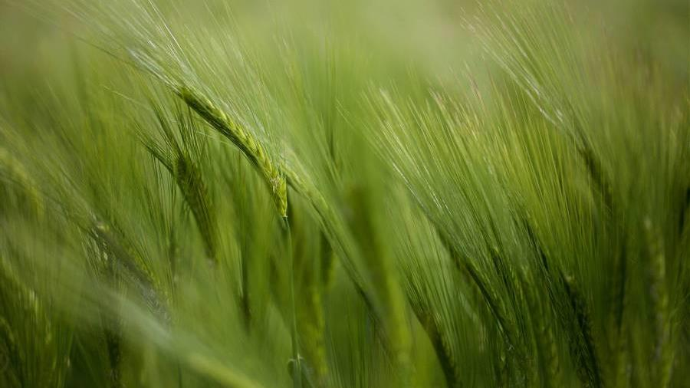
Veggie Tales
Machine Learning to Predict Preference,
Improving Produce Sales and Consumption
From Group 3 (G3)

Slide 2
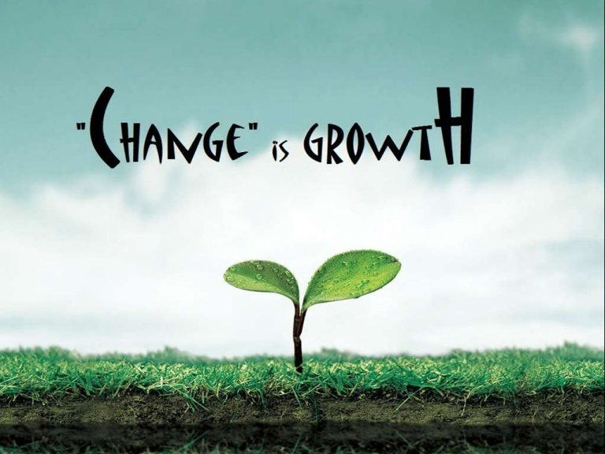
Overview
About Us
Our Inspiration
Concept
Solution
Data Collection
Preparation of Data
Predictive Modeling/Clustering
Visualizations and insights
Conclusions
Questions
Resources

Slide 3
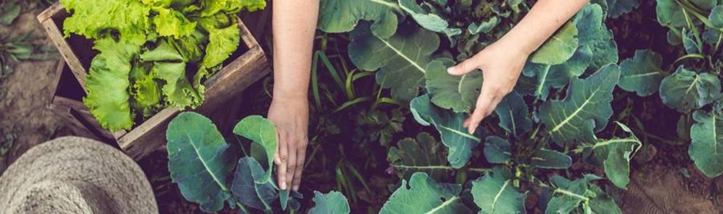
About us
At G3, we strive to empower companies to better anticipate and serve the needs of their customers.
By leveraging predictive and machine learning technology, we can help businesses grow organically and still nurture a consumer first mindset while providing an opportunity to expand access to and consumption of more fresh produce, thus improving overall community health benefits and quality of life.

Slide 4
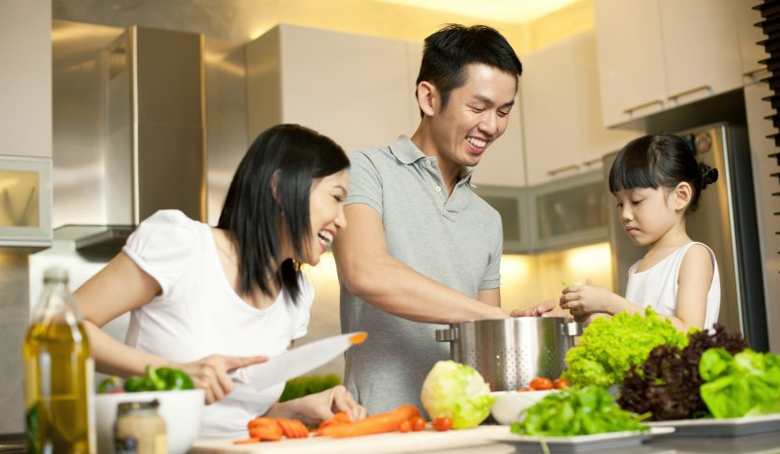
Inspiration
Opportunity
Financials
Consumers
Landscape has forever changed
Grocery has had the biggest shift in shopping habits
Providing recommendations will ease meal planning stress
U.S. shoppers 2022 estimated figures to top out at $85 billion for groceries alone for the year
Monthly grocery spending has more than doubled since pandemic onset
Speed and convenience increasing demands
Sellers adapting rapidly to pick-up and delivery modalities
Inflation and stock issues
Notes:
The ongoing pandemic has changed the landscape of grocery shopping forever. Online grocery shopping has become the new norm, and studies show that most consumers do not intend to go back.
The challenge is what to buy sight unseen, and how to we add variety to our carts without searching endless recipe blogs and Pinterest boards- or even more importantly, how do we know that we would even like something new?
Citation: Forbes- The Pandemic Changed How We Shop for Groceries, Joan Verdon, 3/15/2022 (https://www.forbes.com/sites/joanverdon/2022/03/15/the-pandemic-changed-how-we-shop-for-groceries-adobe-report-shows/?sh=6d7b5c624bb1)

Slide 5

Concept
data
Gather data for various demographics, vegetable types and cooking preferences, and other data points for correlation
Usability
Additional purchases/sales promotion
Improved ordering and inventory planning
Increased health benefits for customers
Future expansion to include recipes, etc.
technology
Use Machine Learning (ML) to process the data and make predictions based on what the customers select, or those with similar likes
Integration
Easy to use, adaptable coding
Notes:
We created a survey that we asked our families, friends, and colleagues to fill out regarding their vegetable eating habits and which vegetables they preferred.
We also asked questions regarding their favorite fruits and TV shows hoping that we may also be able to use machine learning to see if we could find any preferences linking these variables to vegetable preferences.

Slide 6
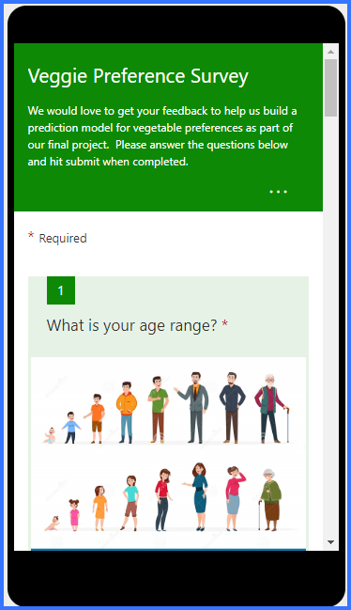
solution
Target usage
Online grocery and delivery services
Consumers looking to expand their menus or find foods their families will eat
Collect the data
Microsoft Forms was used to collect baseline data via surveys from consumers across a wide range of demographics and locations
Easy to use
A simple integration that gives customers recommendations to purchase additional produce based off preferences from those with similar selections, as well as their current cart and recent selections
Costs
Reduce expenses for replacement products
Minimal licensing fees for software tools
Notes:
We spent some time designing the questions we wanted to ask, and how we wanted respondents to rank choices, etc.
There were some limitations on the size and options for this, so it made initial data clean up a little more complex. More about this issue in lessons learned section.

Slide 7




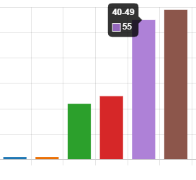
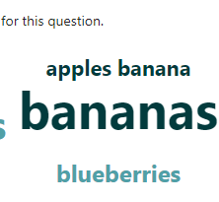

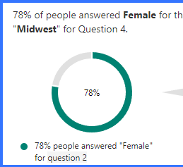
baseline Data collection
Targets
design
delivery
insights
Variety
Factors, Frequency, Favorites
Forms Survey Shared
Did We Meet the Mark?
Notes:
~175 responses in two days, from a wide range of demographics were collected and downloaded from Microsoft Forms into .xlsx
32% of respondents were age 0-65; 95% were from the Midwest; 76% female; the majority were Caucasian, non-Hispanic; the main frequency of vegetable consumption was 3-7 days a week;
Broccoli, carrots, lettuce, corn and green beans were the most common top five favorites in general
Same for at home favorites
Similar results for restaurants but the “other” category spiked up since someone else would be preparing it
Baked, sauteed, grilled, steamed and air-fried were the top preferred prep methods
Bananas was top favorite fruit

Slide 8




Preparation of baseline Data
Conversion
Clean up
compiling
Collaborative filtering
Exporting from Forms
.xlsx to .csv
Creating dataframes (DFs)
Adding new columns back into main DF
Dropping/renaming columns as needed
Using delimiters to split response choices
Manual cleaning for uniform responses and better grouping
Binning rare responses to “other”
Assigning numeric IDs to elements for predictive analysis
New DF creation with User ID, veggie ID and chosen value
Mapping out users and preferences to allow for predictions based on other similar profiles and preferences
Modelling and Tensors feeding
Notes:
We were able to easily download the survey responses from Forms, and then converted to .csv to make dataframes
A LOT of cleaning and prep went in to getting the data ready to process and analyze. People adding extra characters and free text answers, misspellings, etc. made it harder to group at the start.
creating a dataframe that included only the user 'id', the 'veg_id', and a value of '1' to indicate that the user likes this vegetable
creating a dataframe that indicated which vegetables the user did NOT like and gave it a value of '0'
Using random generator to select an equal number of rows that have 0
In the end we had a dataset that had three columns - user 'id', 'veg_id' and 'likes' and 1750 rows where there were 875 rows with 1s (indicating like) and 875 rows with 0s (indicating not on their list of likes).
We then applied the collaborative filtering to this dataset and found that we could predict what

Slide 9
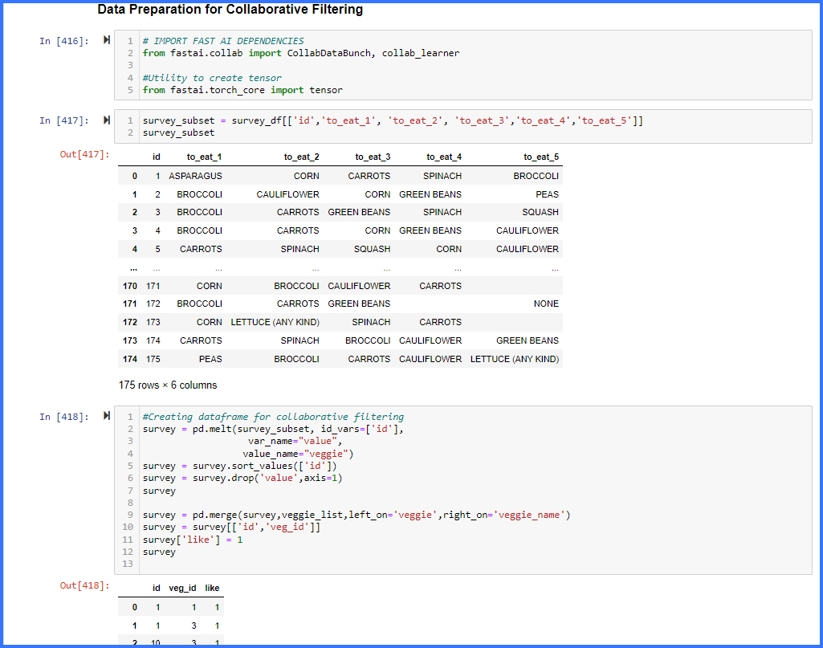
CODING PROCESS

Slide 10
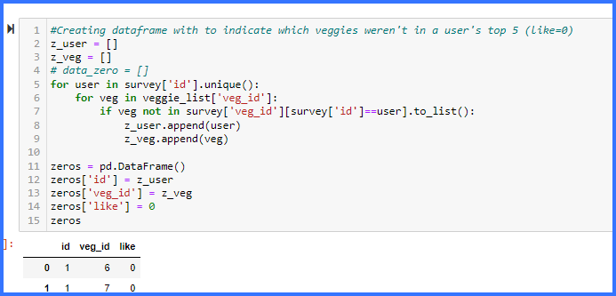
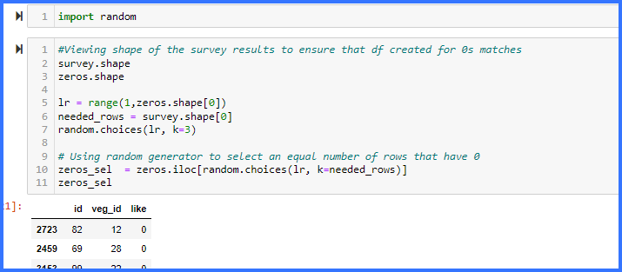
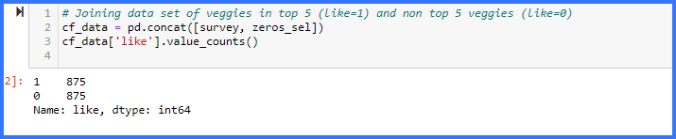
CODING PROCESS

Slide 11
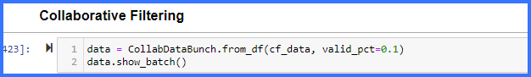
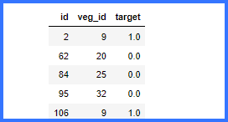
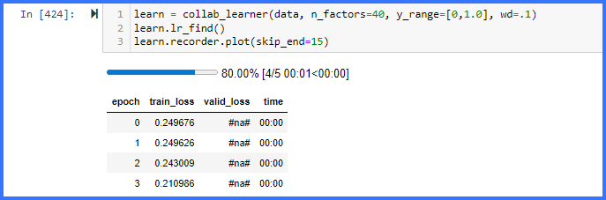
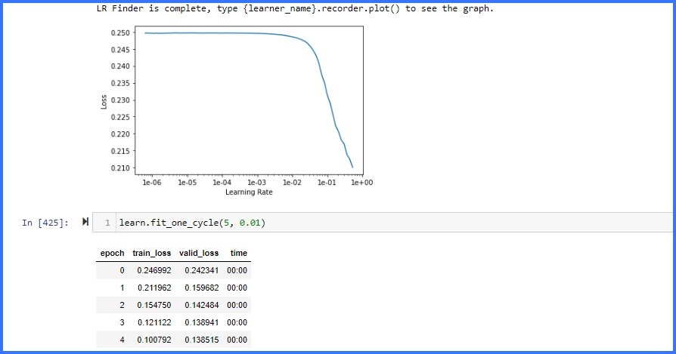
CODING PROCESS

Slide 12
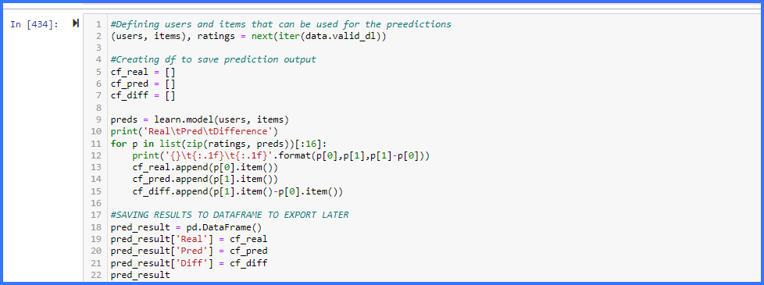
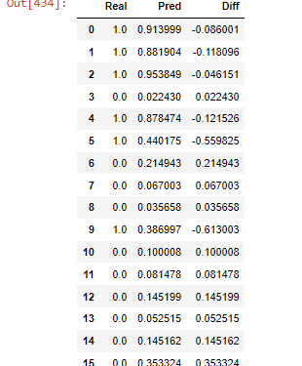
CODING PROCESS

Slide 13
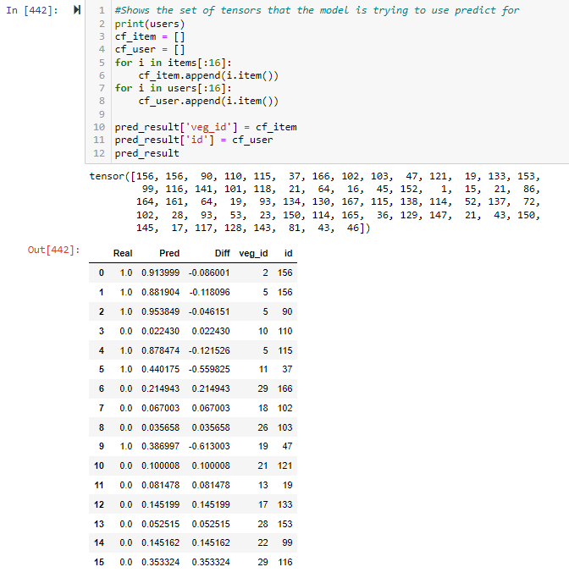
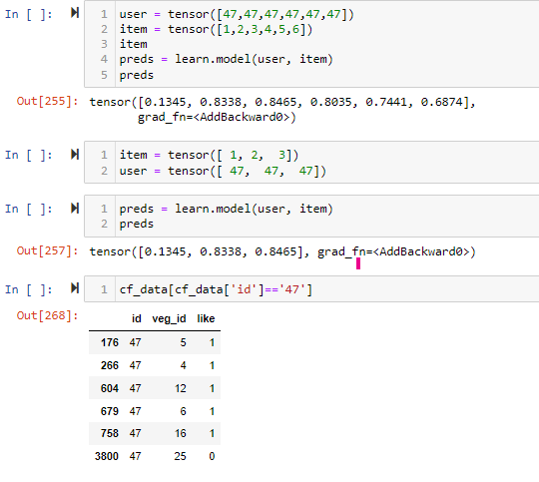
CODING PROCESS

Slide 14
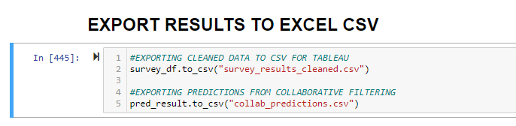

Visualizations and insights
Veggie Tales (Project 4) | Tableau Public

Slide 15

Conclusions
Mapping out the predictions worked well.
We were able to get some interesting insights for other correlations as well.
This model offers opportunities to make suggestions for additional purchases and other types of vegetables and fruit- win/win for customers and sellers!

Slide 16
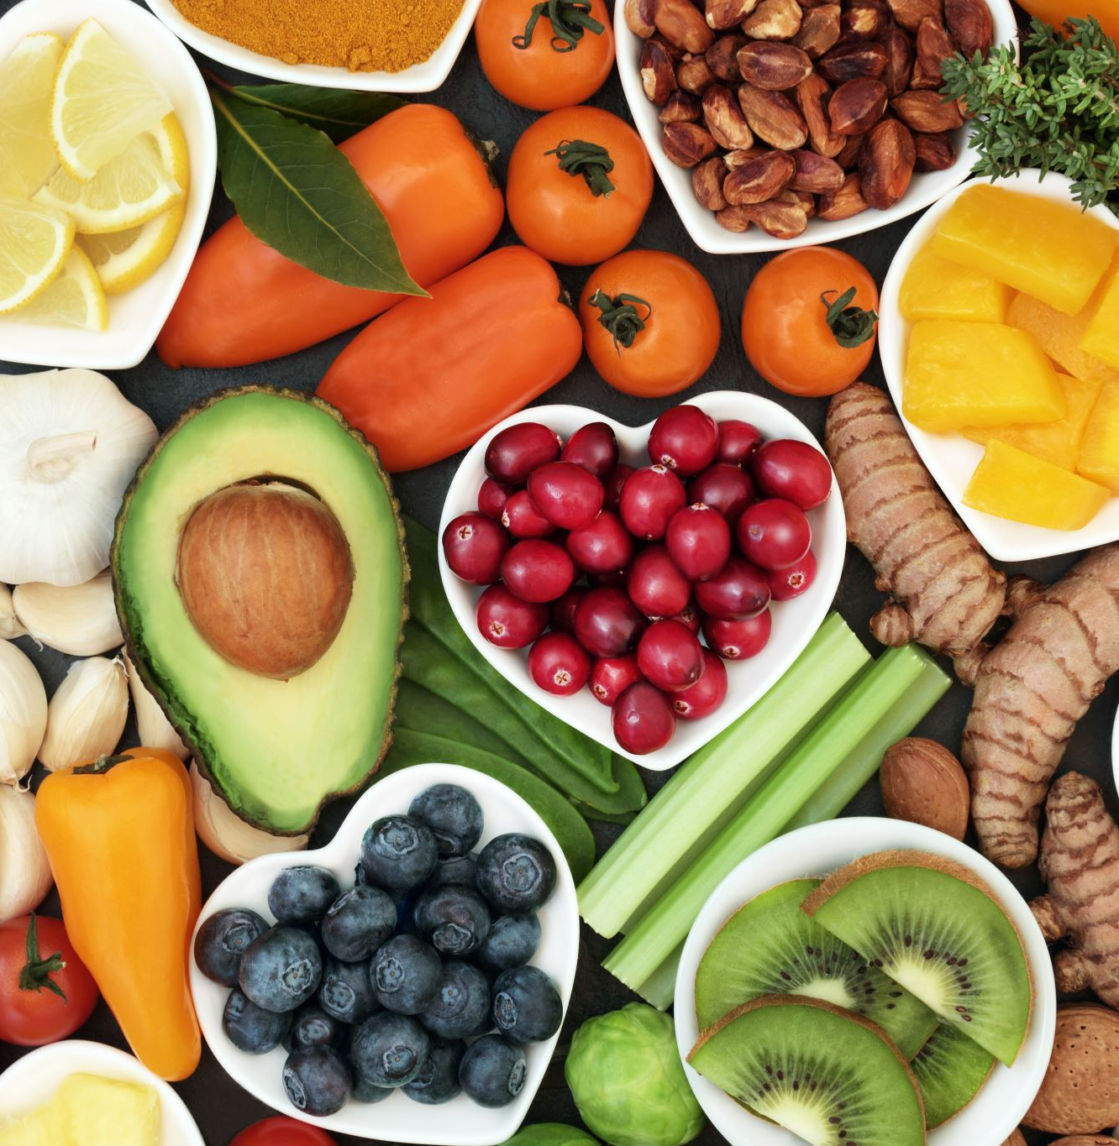
Lessons Learned
A wider variety of baseline data is required to improve prediction rates if this were a real product.
The Forms survey tool is great for distribution and access, but the formats were slightly limited.
There are a lot of opportunities for testing, expanding, and improving this model with more time.
Clustering didn’t help with this application model.
Limiting user text entry would have made initial data clean up and binning/grouping much smoother.

Slide 17
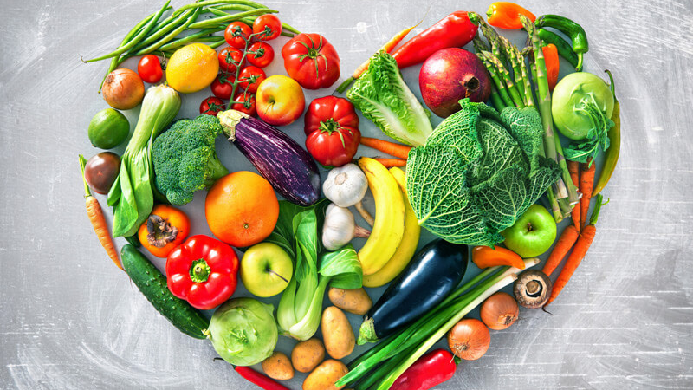
Thank you! Questions?
Notes:
Special thanks to Mohamed for helping us with great advice and identifying solid resources for Fast AI and Collaborative Filtering on this project, and to all the instructors for all the knowledge, guidance, and insight as we charged through this bootcamp!

Slide 18
Our team
G3
Pam Fernandez
Brenna Kelly
Emma Dublin

Slide 19

References/Resources
Our GitHub Repo: https://github.com/PamFernandez/veggie-tales.git
Survey Formatting:
https://www.formpl.us/blog/age-survey-questions
https://www.whereig.com/usa/map-the-united-states-regions.html
http://www.atlas101.ca/pm/resource-pages/race-ethnicity-nationality-and-culture/
Coding Resources:
https://builtin.com/data-science/collaborative-filtering-recommender-system
https://www.analyticsvidhya.com/blog/2022/02/introduction-to-collaborative-filtering/
https://www.fast.ai/
https://medium.com/analytics-vidhya/collaborative-filtering-a-sincere-perspicacity-ad034113878b
https://realpython.com/build-recommendation-engine-collaborative-filtering/#:~:text=Collaborative%20filtering%20is%20a%20technique,similar%20to%20a%20particular%20user.
https://jovian.ai/aakashns/movielens-fastai
https://towardsdatascience.com/collaborative-filtering-using-fast-ai-f33cfea62812
https://pandas.pydata.org/docs/reference/api/pandas.DataFrame.iterrows.html
https://stackoverflow.com/questions/28654047/convert-columns-into-rows-with-pandas
General Info:
https://www.forbes.com/sites/joanverdon/2022/03/15/the-pandemic-changed-how-we-shop-for-groceries-adobe-report-shows/?sh=6d7b5c624bb1

